Slide 1
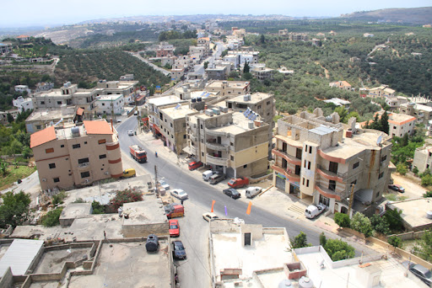

Innovating Green Technology-IGT
www.igt.ac

Slide 2
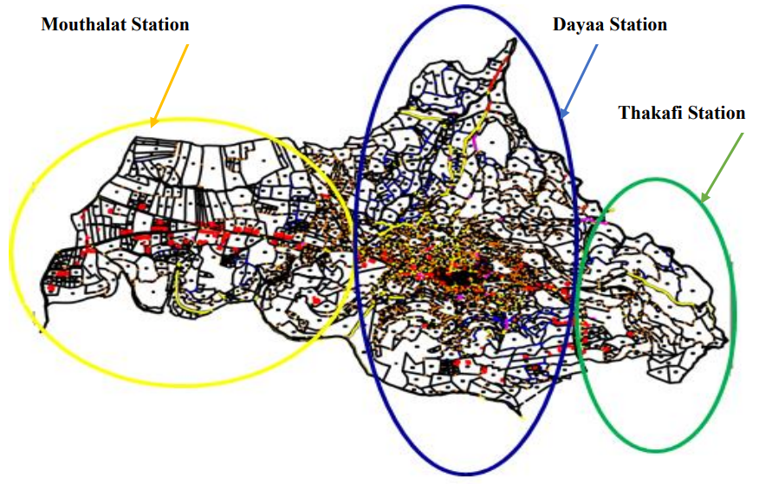

Energy Situation in Deir Kanoun - Lebanon
15,000 Inhabitants with 1150 households and 194 commercial/industrial units
Three micro grids:
1. Mouthalat Station
scania 600 - scania 400 - volvo 385
2. Dayaa Station
scania 600 - scania 400 - volvo 630
3. Thakafi Station
scania750 - scania 275

Slide 3
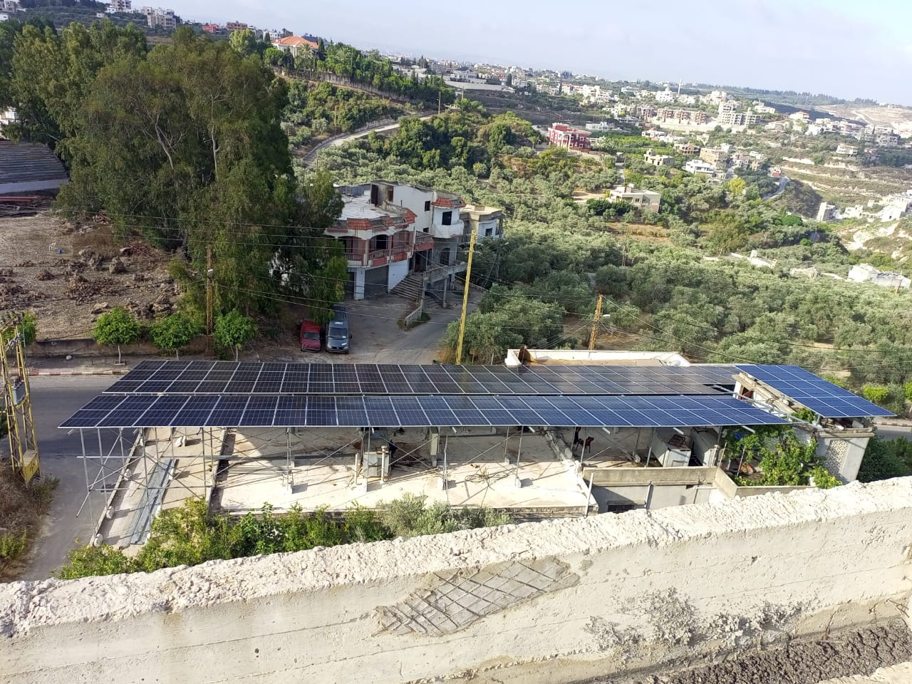
Energy Situation in Deir Kanoun - Lebanon
Three Solar farms:
1. Solar Water pumping connected to Mouthalat Station
130 Kw solar water pumping farm
2. On-grid Solar Farm connected to Dayaa Station
430 Kw On-grid solar farm
3. Solar Water pumping connected to Thakafi Station
180 Kw solar water pumping farm
This is on-top of 550 Rooftop solar systems

Slide 4
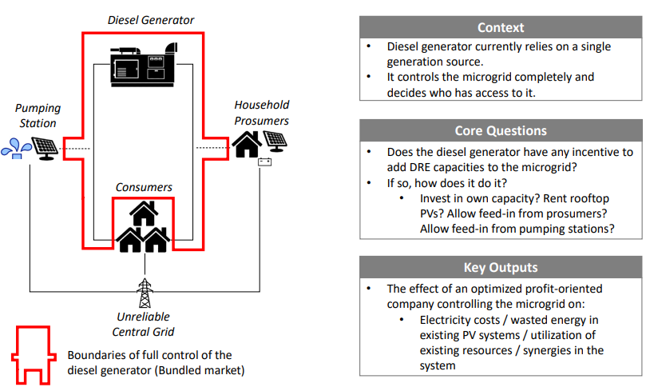
Integrated Optimization Scheme

Slide 5

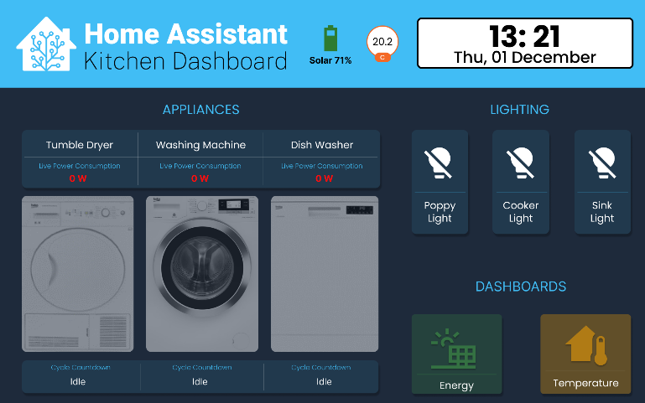
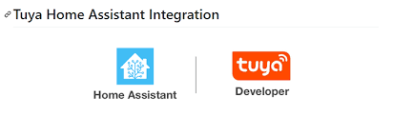
IGT Optima Scheme –Monitoring and Automation Component

Slide 6
Optima in Deir Kanoun - Lebanon
Three micro grids:
1. Mouthalat Station
Ali Hariri: 8 panels/ 5 kw inverter/ 8.7 Kw Lithium Battery, no generator subscription
Youssef Al Husseini: 40 A generator subscription
Abed Al Hadi Ballout: 8 panels/ 5 kw inverter/ 8.7 Kw Lithium Battery, 5 A generator subscription
2. Dayaa Station
Baladie: 36 panels/ Three 5 kw inverter/ 12 acid batteries 200 Ah each, 40 A generator subscription
3. Thakafi Station
Issam Ezzeddine: 12 panels/5 kw inverter/ 8 acid batteries 300 Ah each, Has a 15 A generator subscription

Slide 7
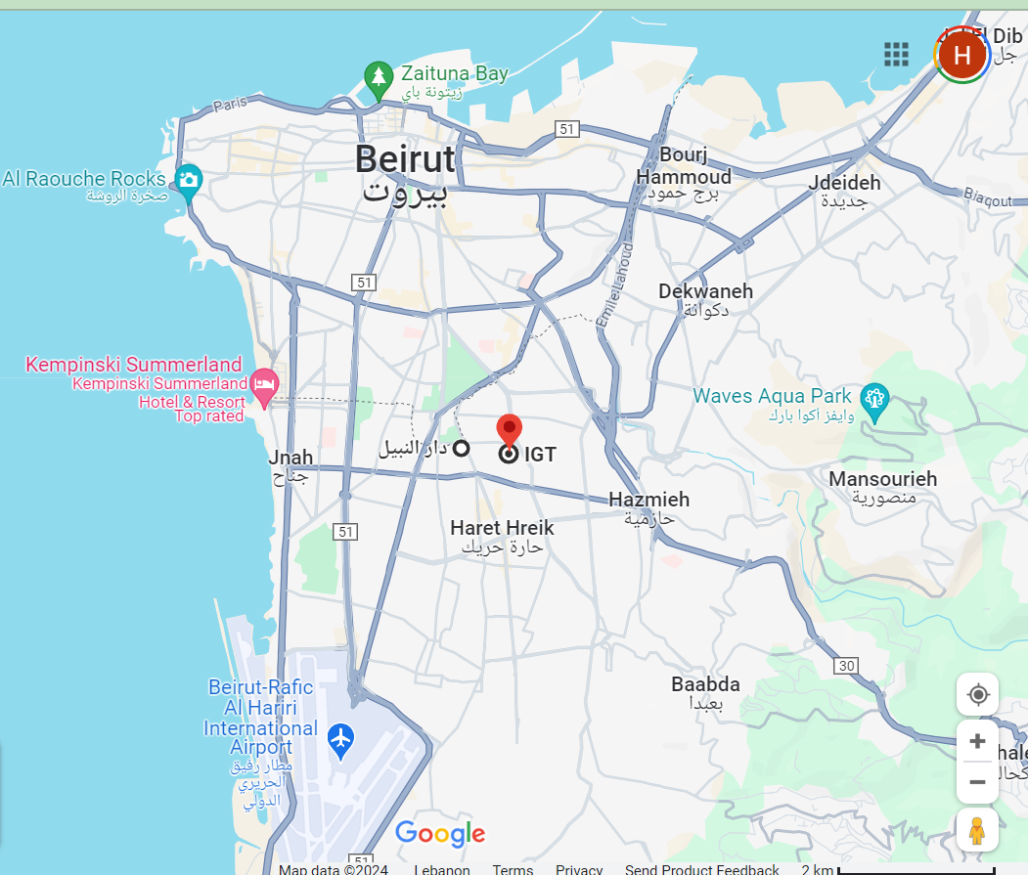
Optima in Beirut- Lebanon
1. IGT Premises
9 panels/ 5.6 kw inverter/ 4 acid batteries 200 Ah each, no generator subscription
2. Nabil Sharafeddine
10 panels/ 5.6 kw inverter/ 8 acid batteries 200 Ah each, 15 A generator subscription

Slide 8
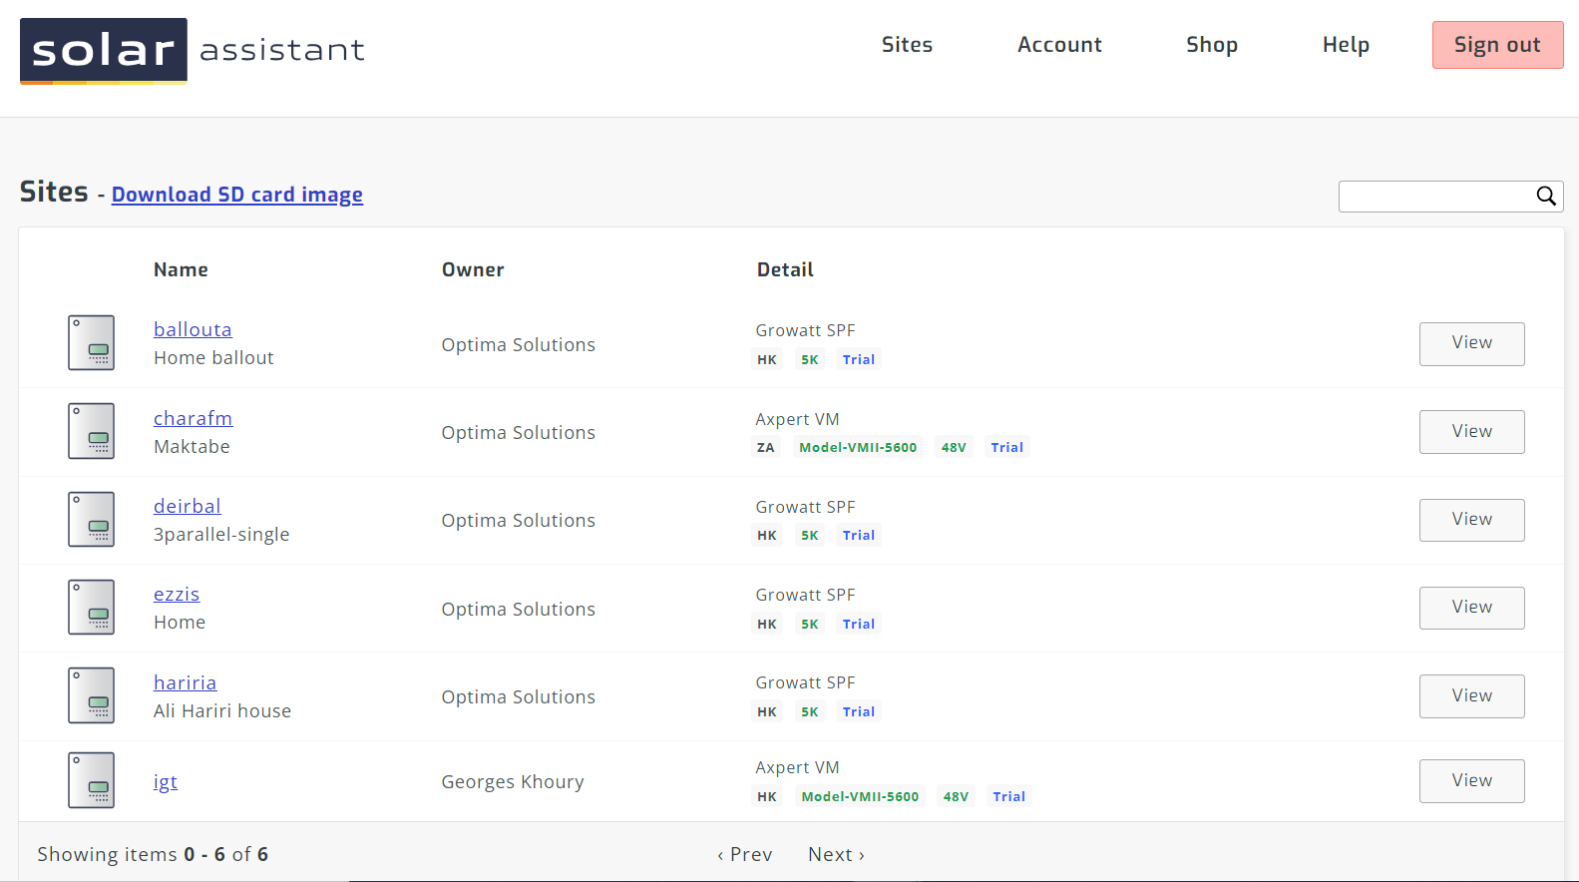
Optima Real-time Monitoring Sites Lebanon

Slide 9
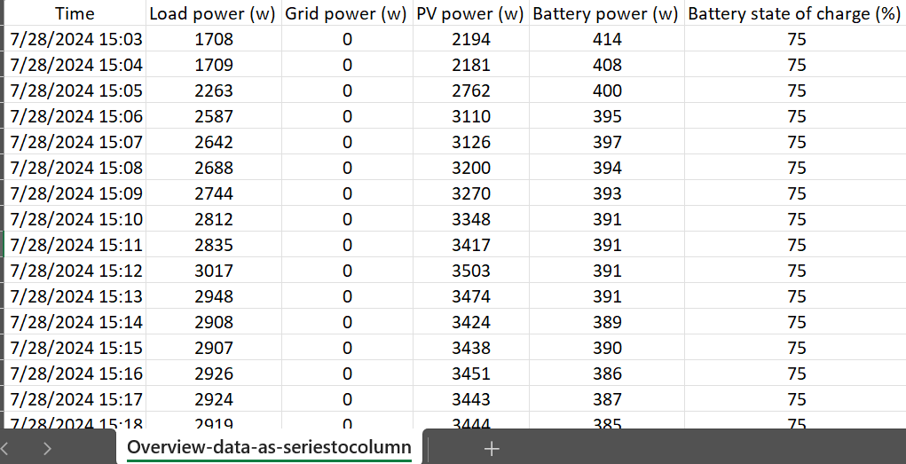
Optima Real-time Monitoring Sites Lebanon

Slide 10
Let’s Get in Touch
www.igt.ac
@igtlb
@igt_lb
Innovating Green Technology – IGT
igtlb
+961 70 25 05 27
+357 99 96 55 19
info@igt.ac

Slide 11
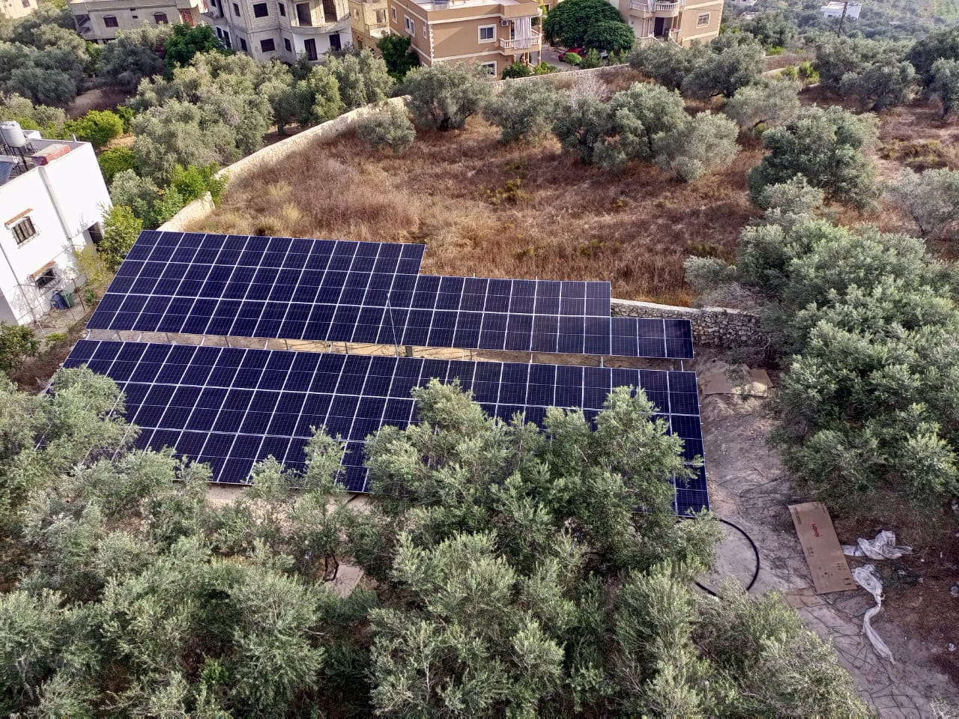
IGT Optima in Deir Kanoun - Lebanon

Slide 12

IGT Optima in Deir Kanoun - Lebanon

Slide 13
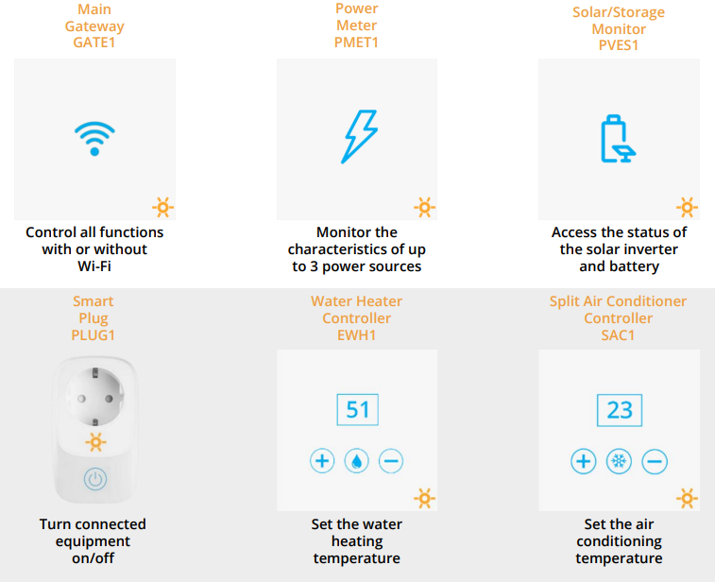
IGT Optima Scheme –Automation Component

Slide 14
About Us
Technology provider company Medium Enterprise Registered in USA and Lebanon since 2017 Working in Lebanon, MENA region & where we must be.
IGT

Slide 15

Mission Statement
We develop green energy solutions that improve efficiency, reliability, and sustainability in various sectors: Water, Energy and Food.

Slide 16

Vision Statement
Creating a future full of green and sustainable energy solutions

Slide 17
IGT Achievements
01
02
03
350+ Implementation
20+ Partner
21+ Training
04
05
06
31+ Awards
18+ Grants
5+ years in Business

Slide 18




Our Services
SOLAR SECTOR
WATER TREATMENT SECTOR
OPTIMA: REVOLUTIONIZING SOLAR SYSTEM
AGRICULTURE SECTOR
IGT Provides the following Solar Systems:
On-Grid | Off-Grid | Hybrid Solar System
Solar Water Pumping System
Solar Water Heater System
Residential Solar Water Heater System
Solar Heating Poultry House
Solar Dehumidifier System
Water treatment is any process that improves the quality of water to make it appropriate for a specific end-use.
IGT Provides the following Water treatment Systems:
Rainwater harvesting and drinking reuse
Grey water treatment and irrigation/household needs reuse
Wastewater treatment and irrigation reuse
Optima, our advanced service, transforms the way your solar systems operate.
Experience elevated efficiency and performance with Optima's revolutionary approach to solar energy.
Agriculture is a primary activity which includes growing plants and rearing of livestock.
IGT Provides the following Agricultural Systems:
Aquaponics
Hydroponics
Fish Breading/Home Aquaculture System

Slide 19


Our Services
BIOFUEL
VOCATIONAL TRAINING
Biofuels are a class of renewable energy derived from living materials.
IGT Provides the following Biofuel Systems:
Biodiesel system
Algae cultivation system and Drier for Biofuel production
Practical and theoretical training for practitioners in the fields of solar energy and engineering

Slide 20
19+ Trainings
Domestic Wastewater Treatment System O&M
Solar Training O&M
Solar Training
Solid Waste Management Training
Agro-food Training
Plumbing Training

Slide 21
IGT Departments
Research & Development
IT Department
Industrial
CEO
Implementation
Marketing Department
Branding & Communication

Slide 22
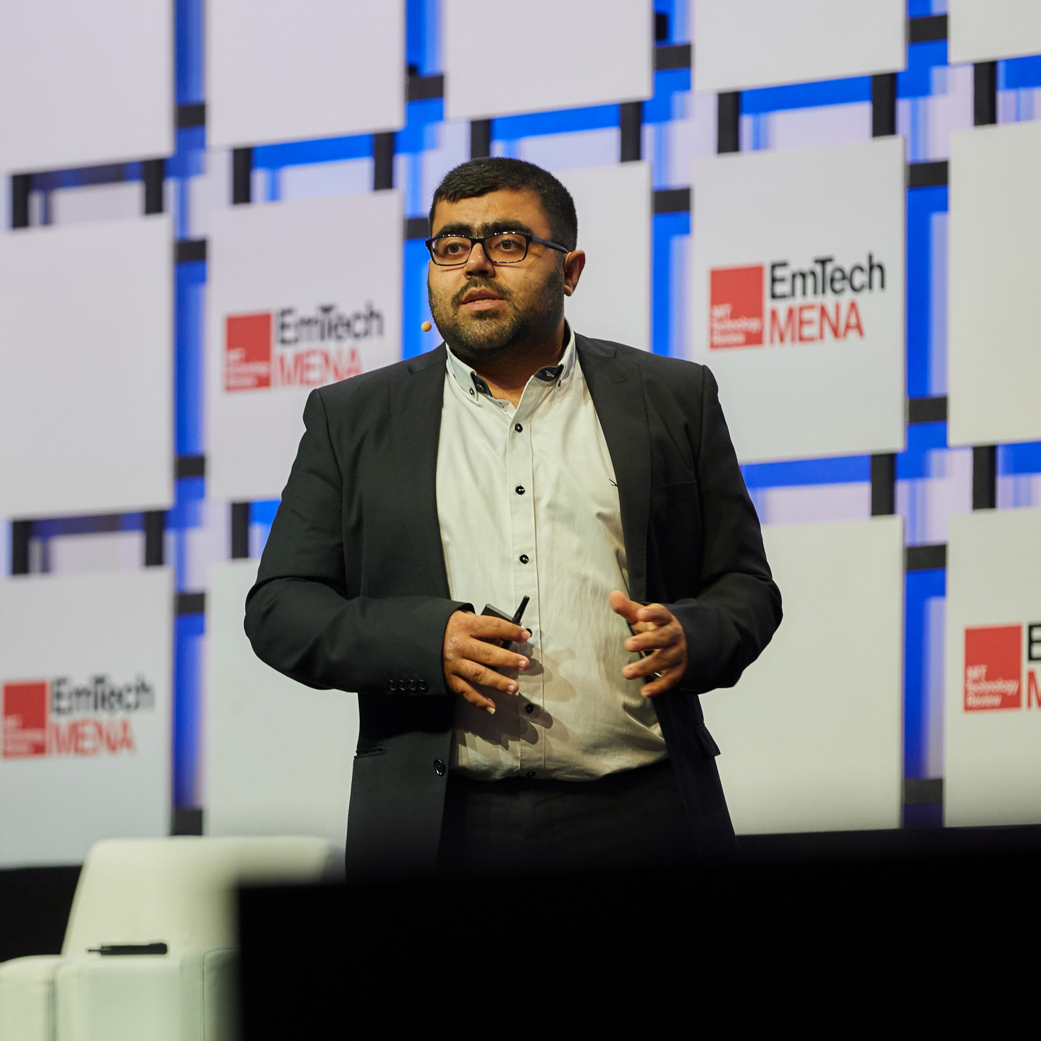
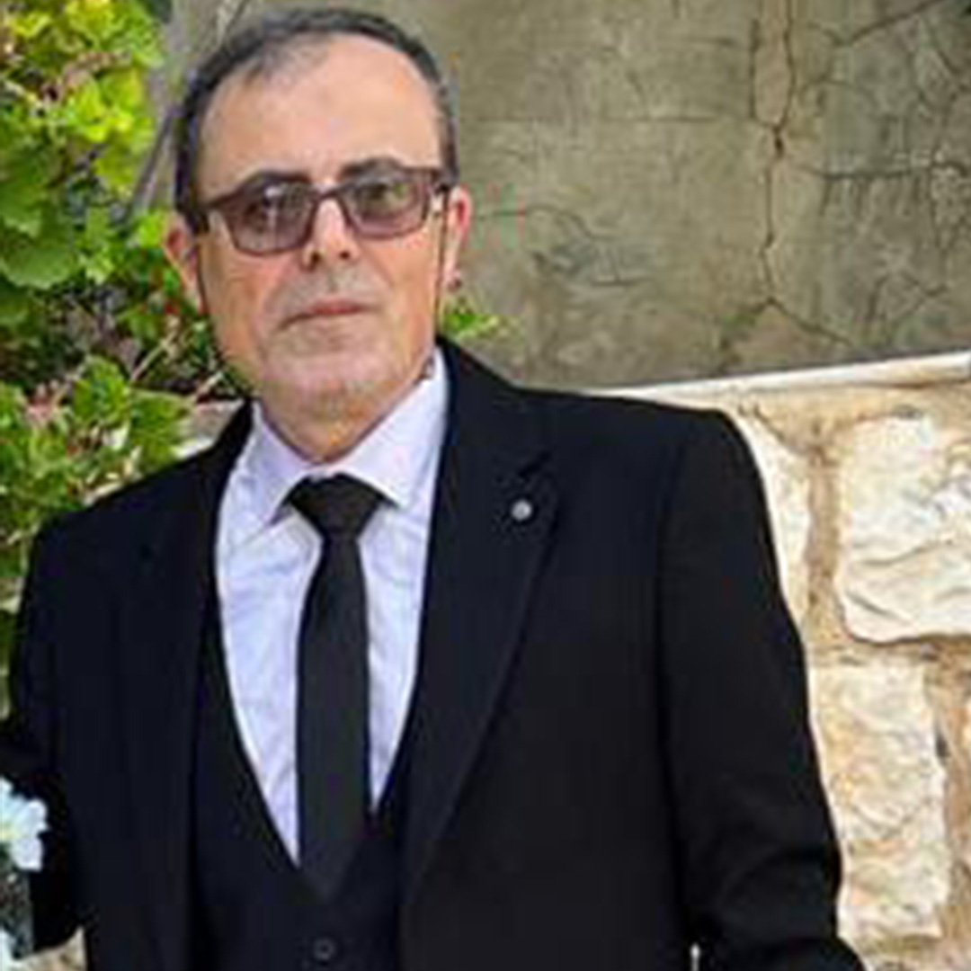
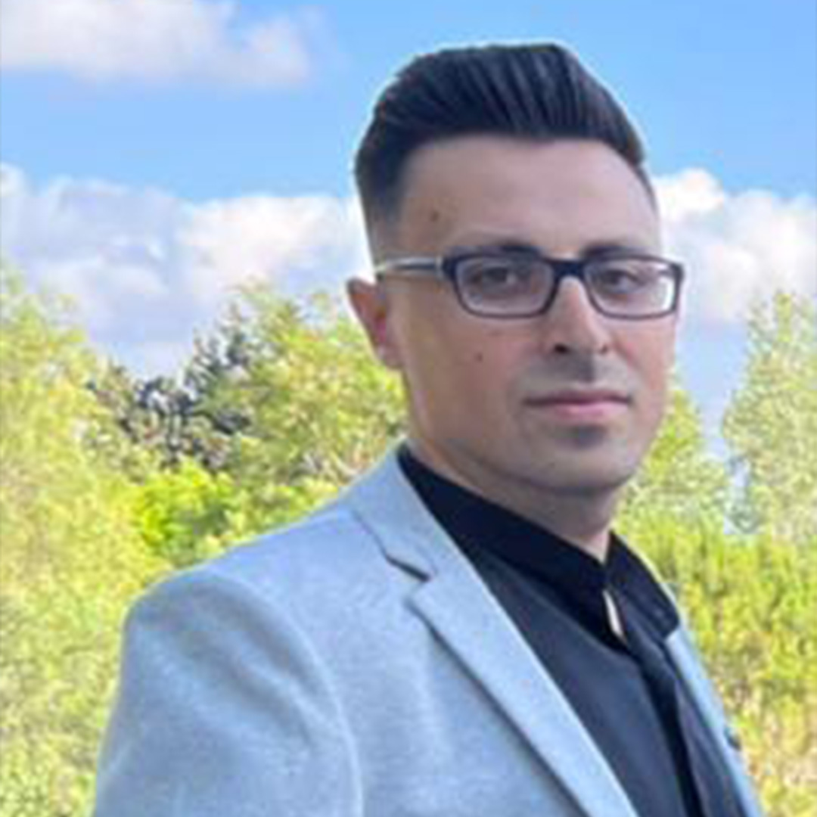
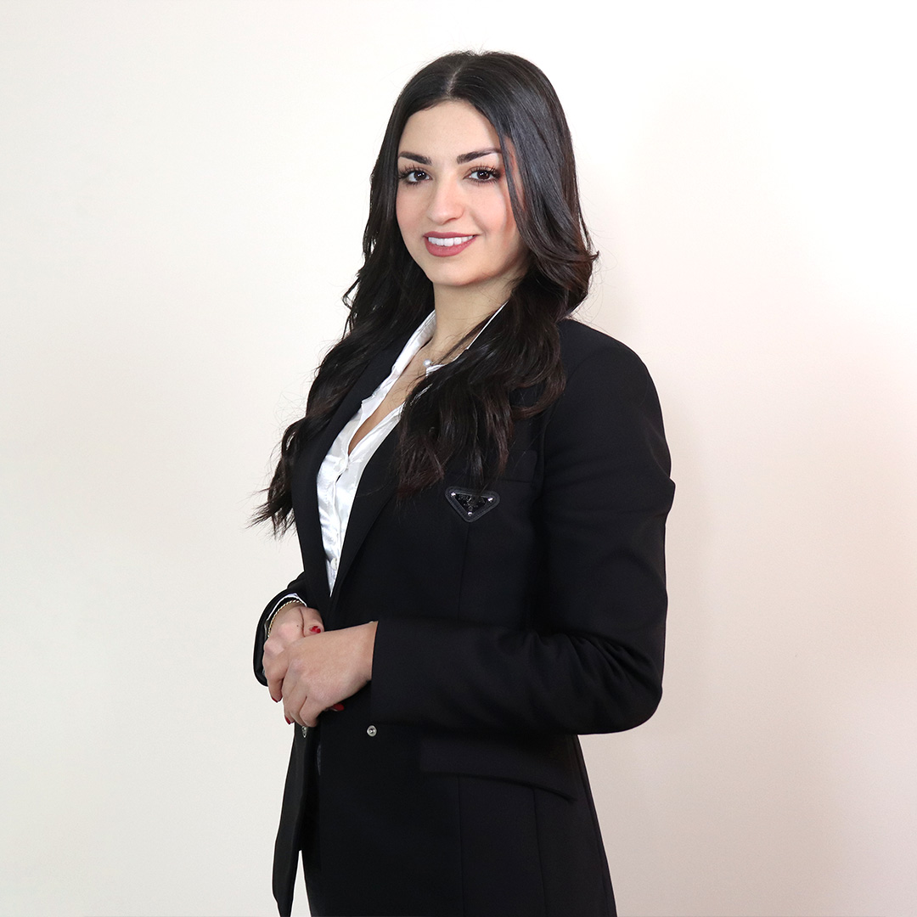
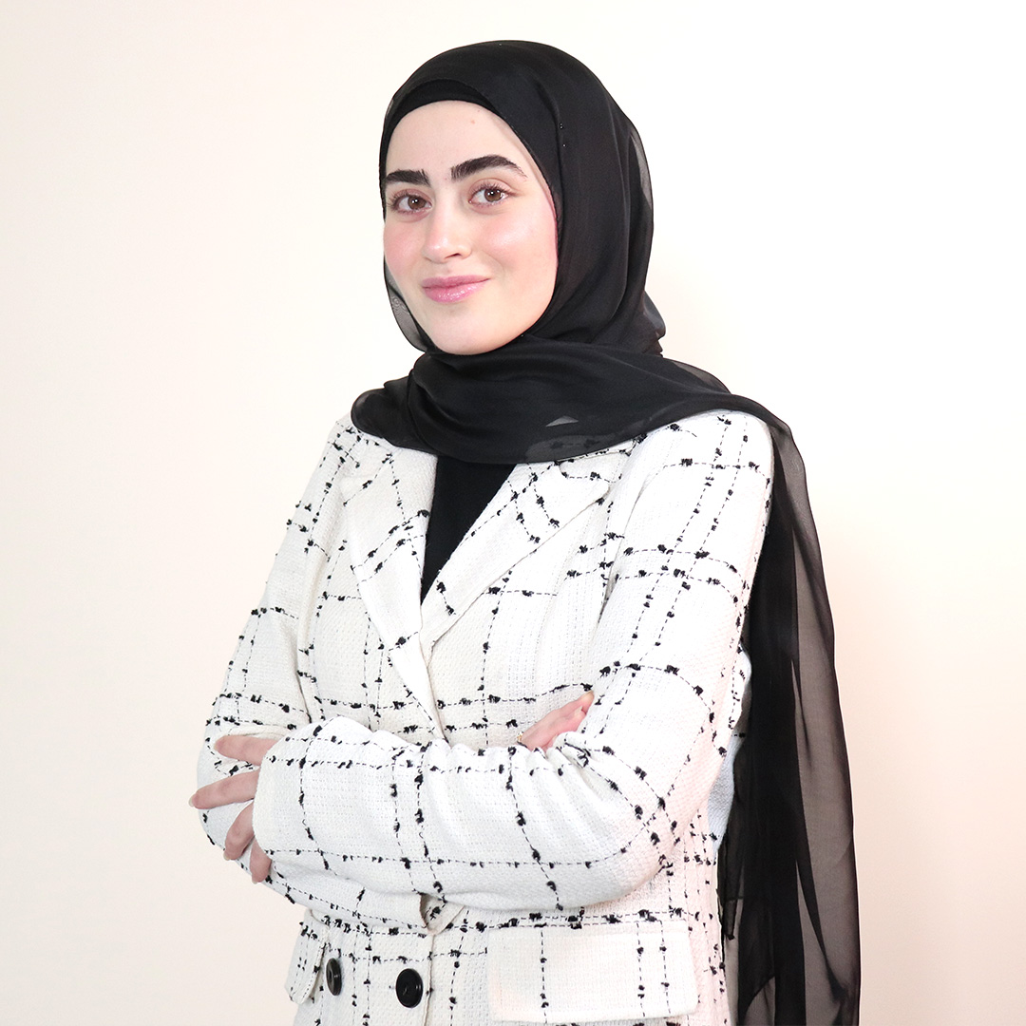

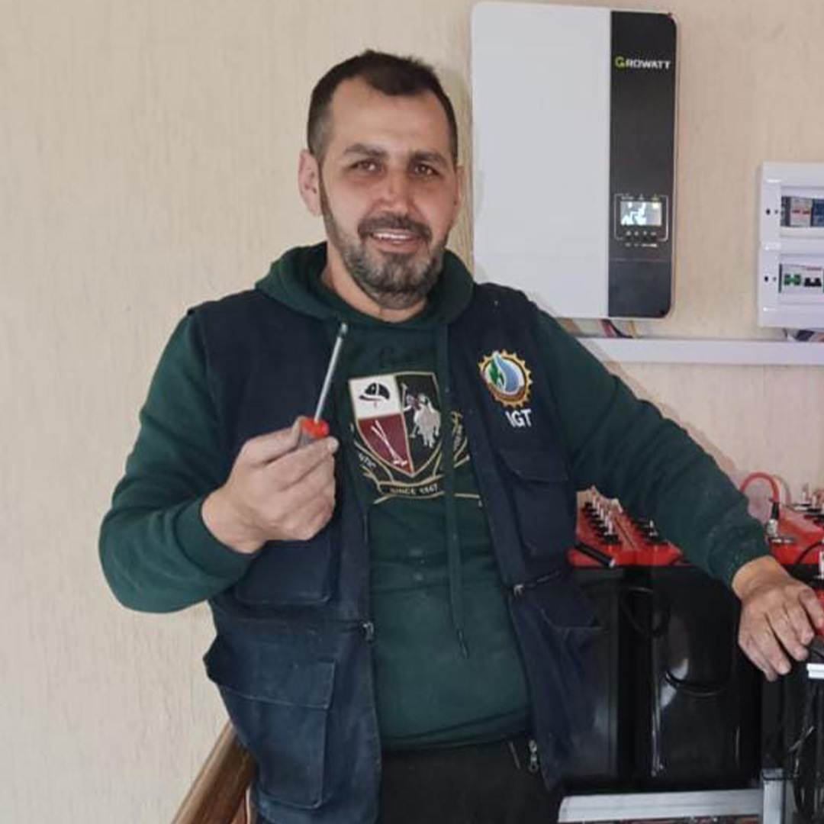
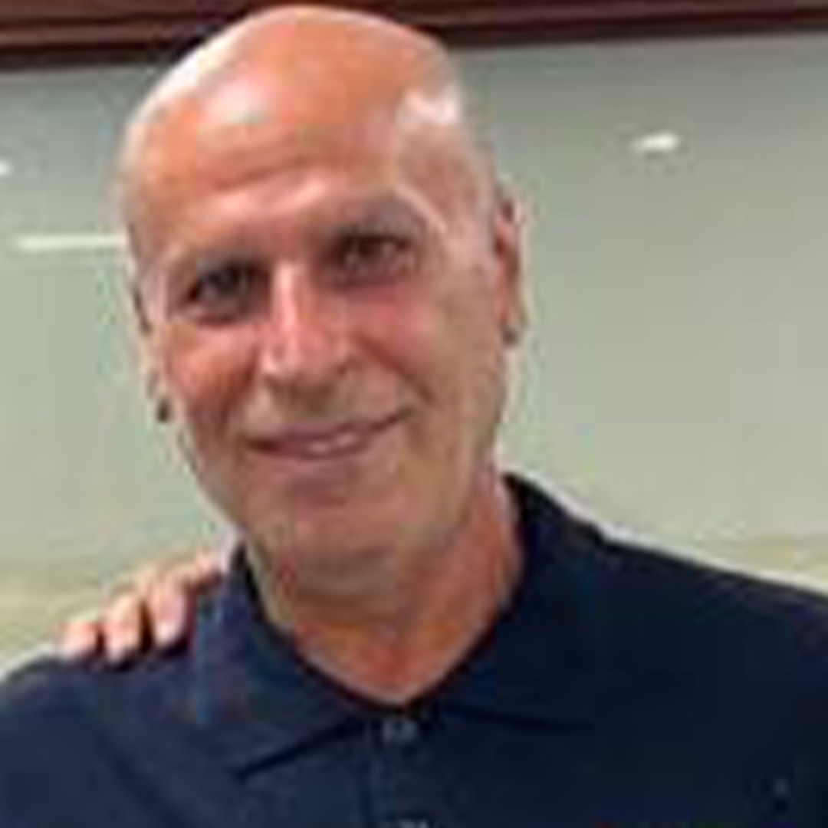
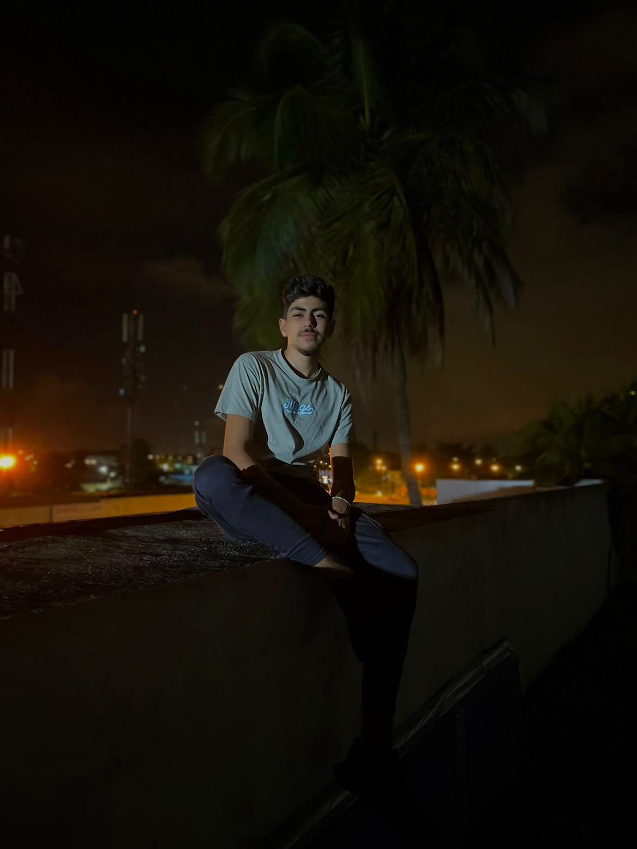
The Masterminds
Dr. Haytham M. Dbouk
Founder & CEO
Mounji Dbouk
Abd el-Raouf Dbouk
VOID LTD
COO
Implementation’s Manager
Layal Attieh
Nour Dbouk
Branding & Marketing
R&D
Agricultural Engineer
R&D
Electrical Engineer
Hassan Hatoum
Fayez Hatoum
Hadi Dbouk
Maintenance Manager
Implementation Team
Implementation Team

Slide 23
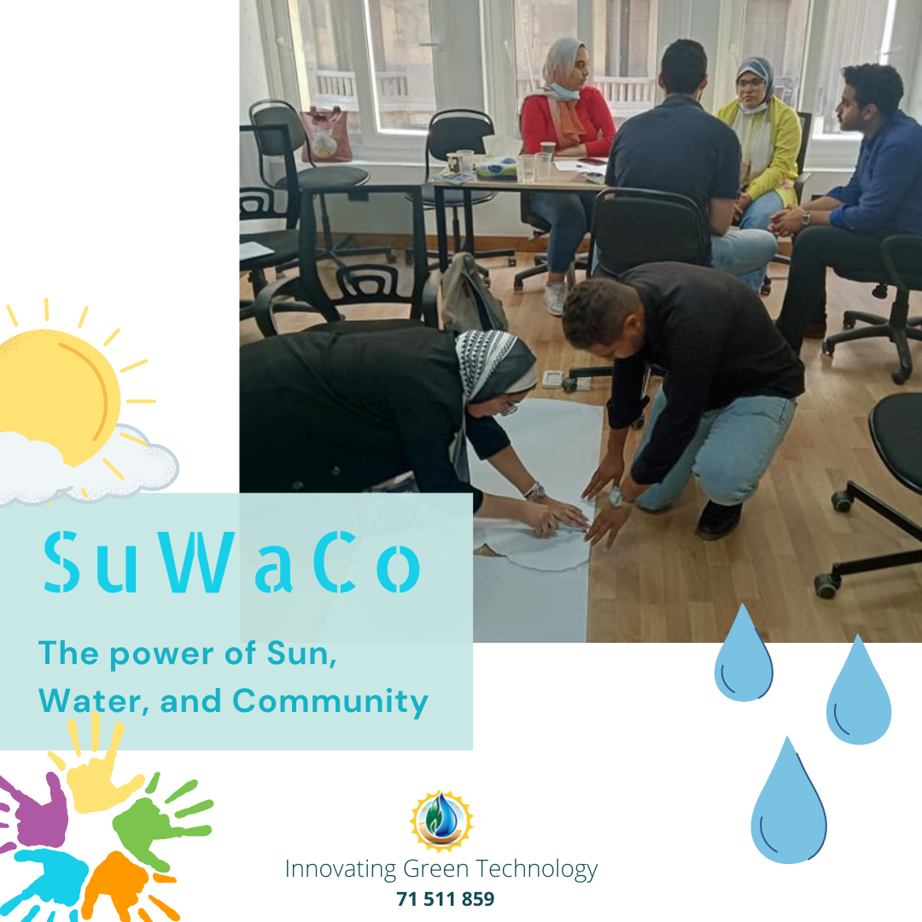
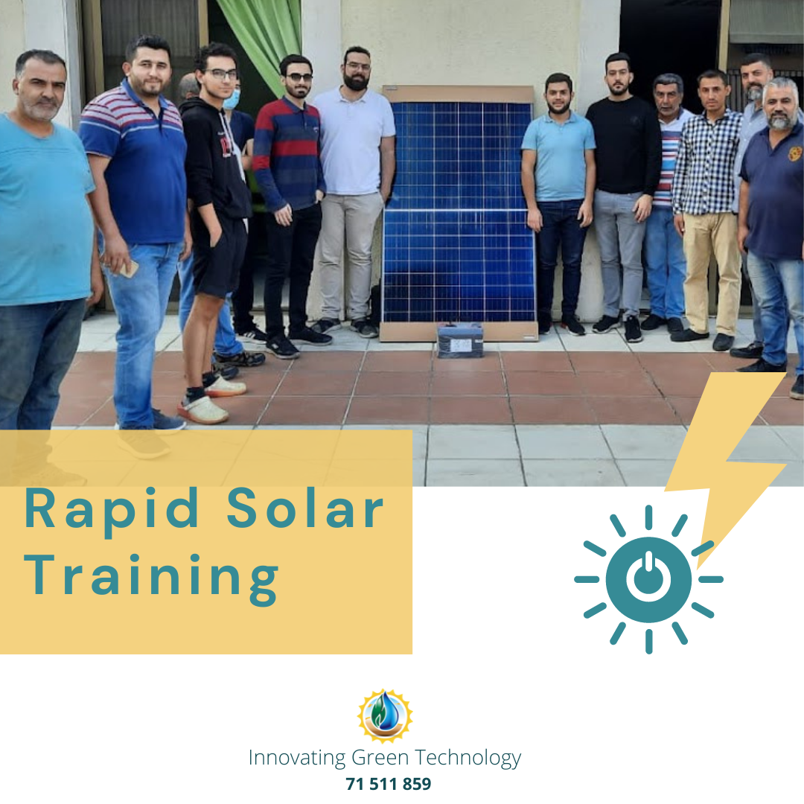
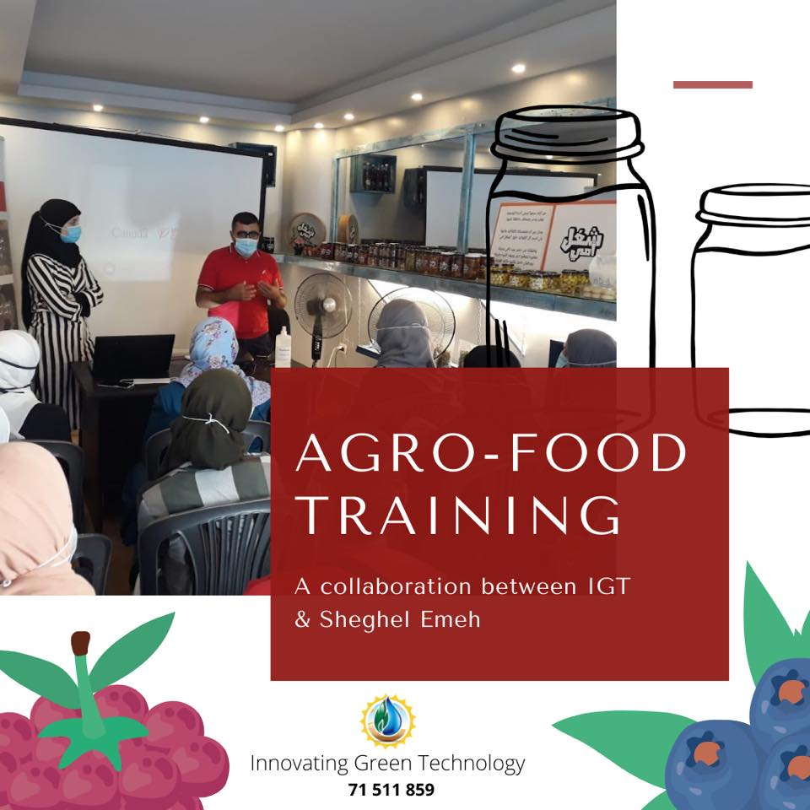
19+ Trainings

Slide 24
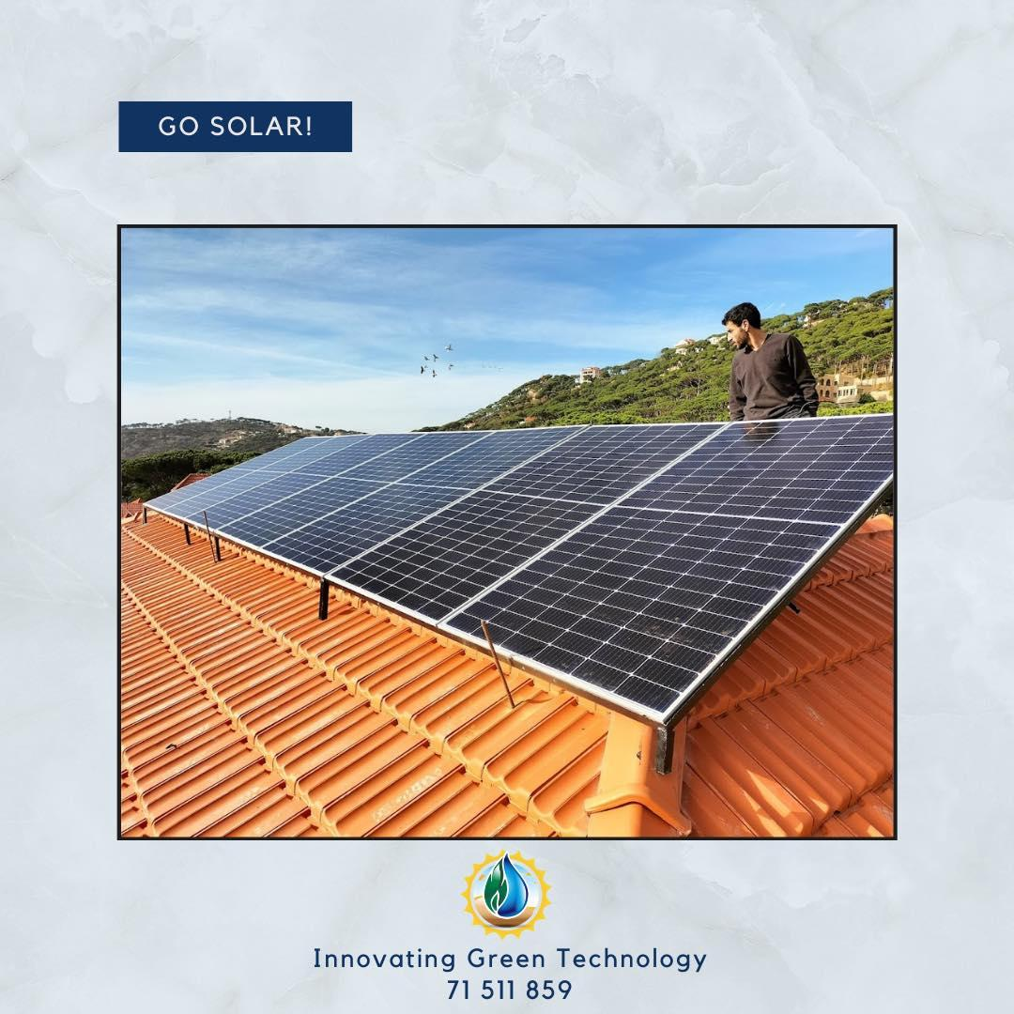
Our Products
50+ Hybrid Solar
System Implementation
🗹 Lebanon
Beirut, Chwaifet, Sour, Saida, Tripoli…
🗹 Egypt
Regwa, Fayoum
Customized your need
Served you everywhere

Slide 25
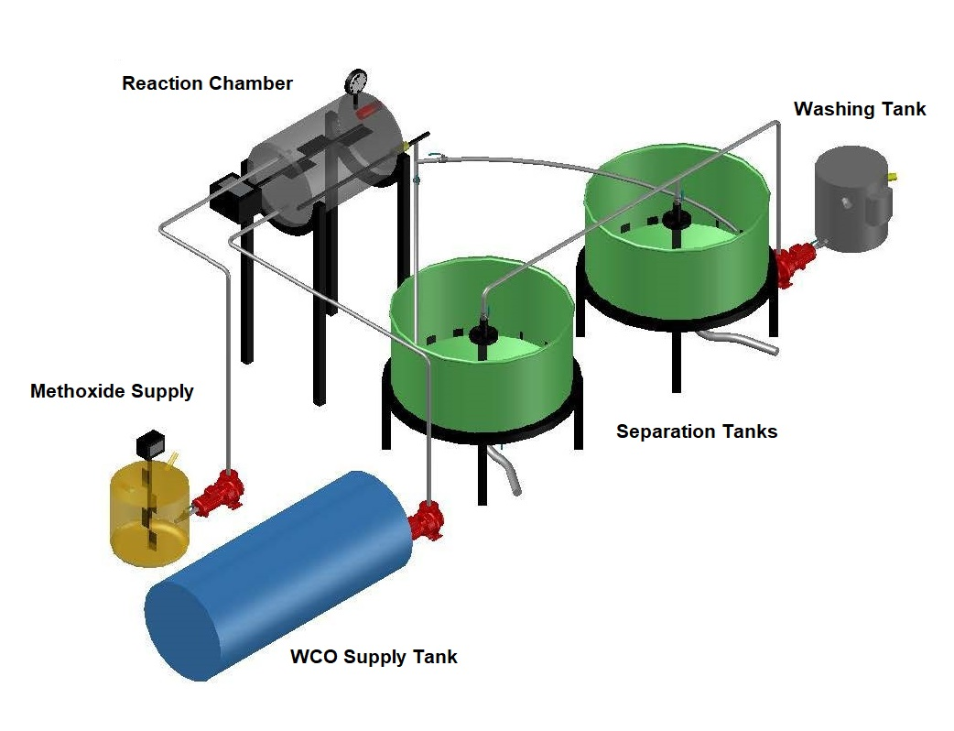
Our Products
IGT Biodiesel Revolution
🗹 Lebanon
Production of
Biodiesel & Glycerin

Slide 26
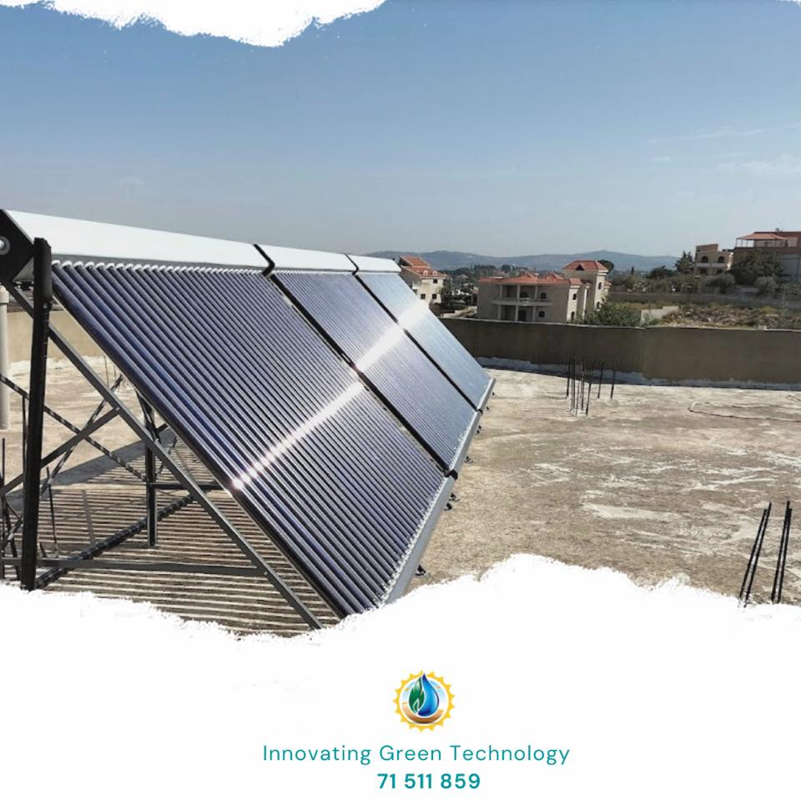
Our Products
20+ Solar Water Heater System
🗹 Lebanon
Beirut, Chwaifet, Naqoura…
Hot water need
Industrial need

Slide 27
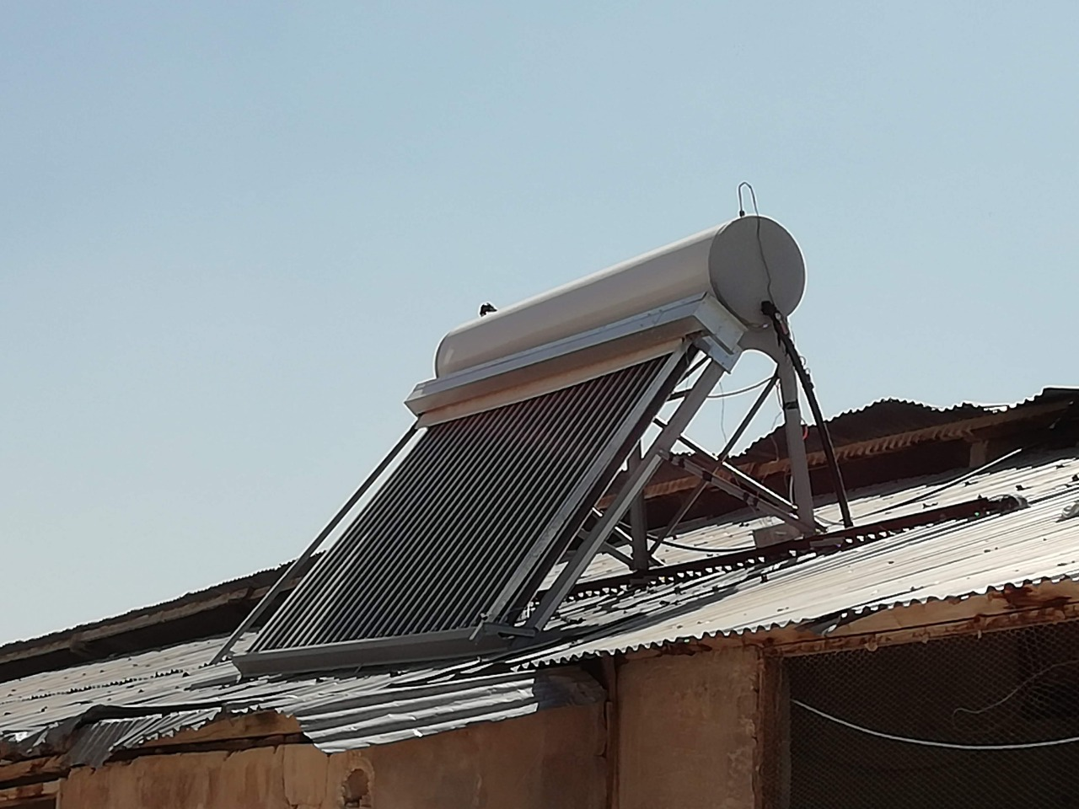
Our Products
25+ PRO-Shield
(2) Patents in 2017

Slide 28
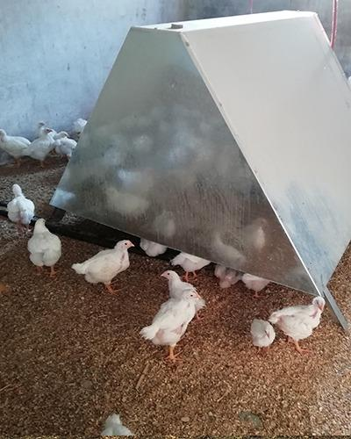
Our Products
5+ Solar Heated Poultry House
🗹 Lebanon
🗹 Egypt
Boosting poultry house productivity
Maximizing poultry house efficiency
Making this sector flexible and more efficient

Slide 29
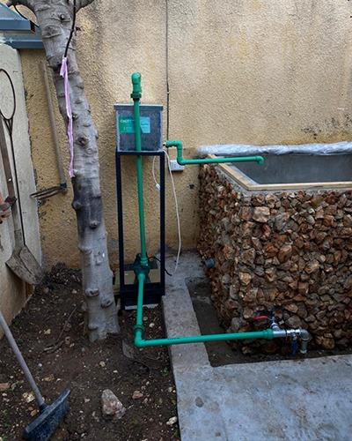
Our Products
6+ IGT Bio-filter
🗹 Lebanon
Customized for your household
Lifetime, No need to change

Slide 30
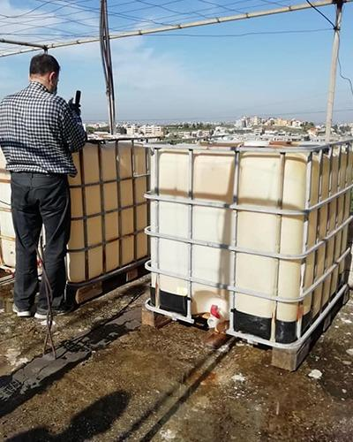
Our Products
15+ Fish Breeding System
🗹 Lebanon
Customized for your household
An additional source of income
Cover your protein need

Slide 31
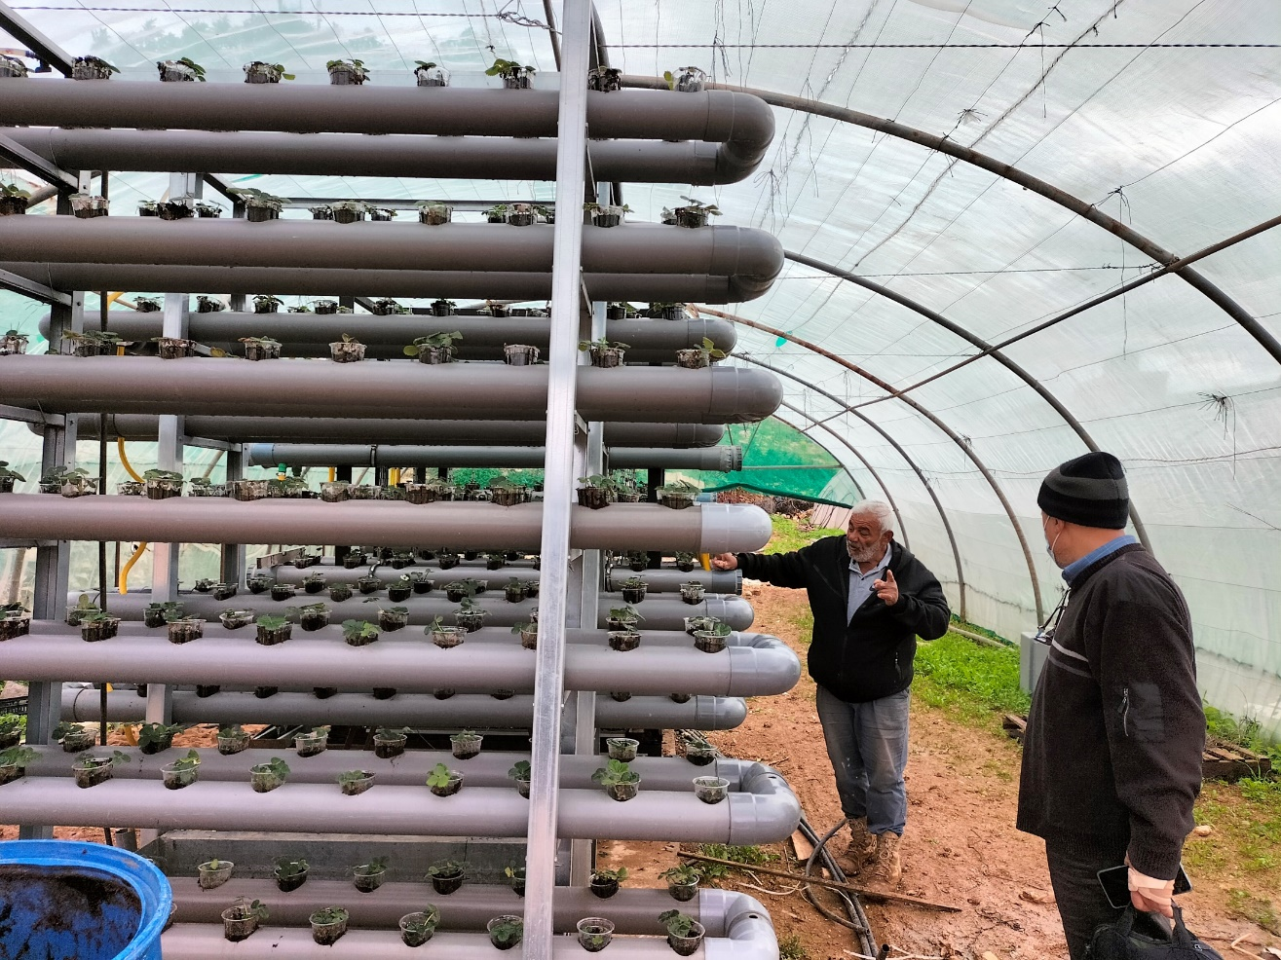
Our Products
3+ Hydroponics System
🗹 Lebanon
Minimize chemical usage
Assure food security
Optimize water usage
boost smart farming

Slide 32
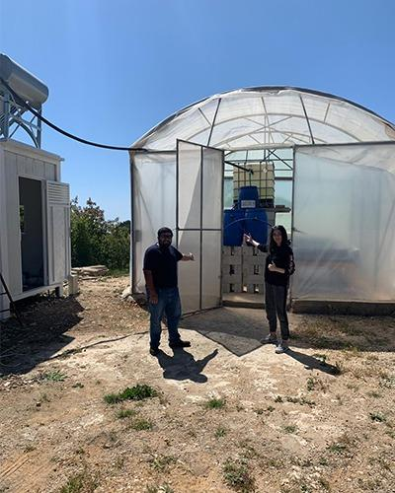
Our Products
7+ Aquaponics System
🗹 Lebanon
🗹 Egypt
Boost your yield productivity
Optimize space usage
Fully automated, No labor needed
No soil needed

Slide 33
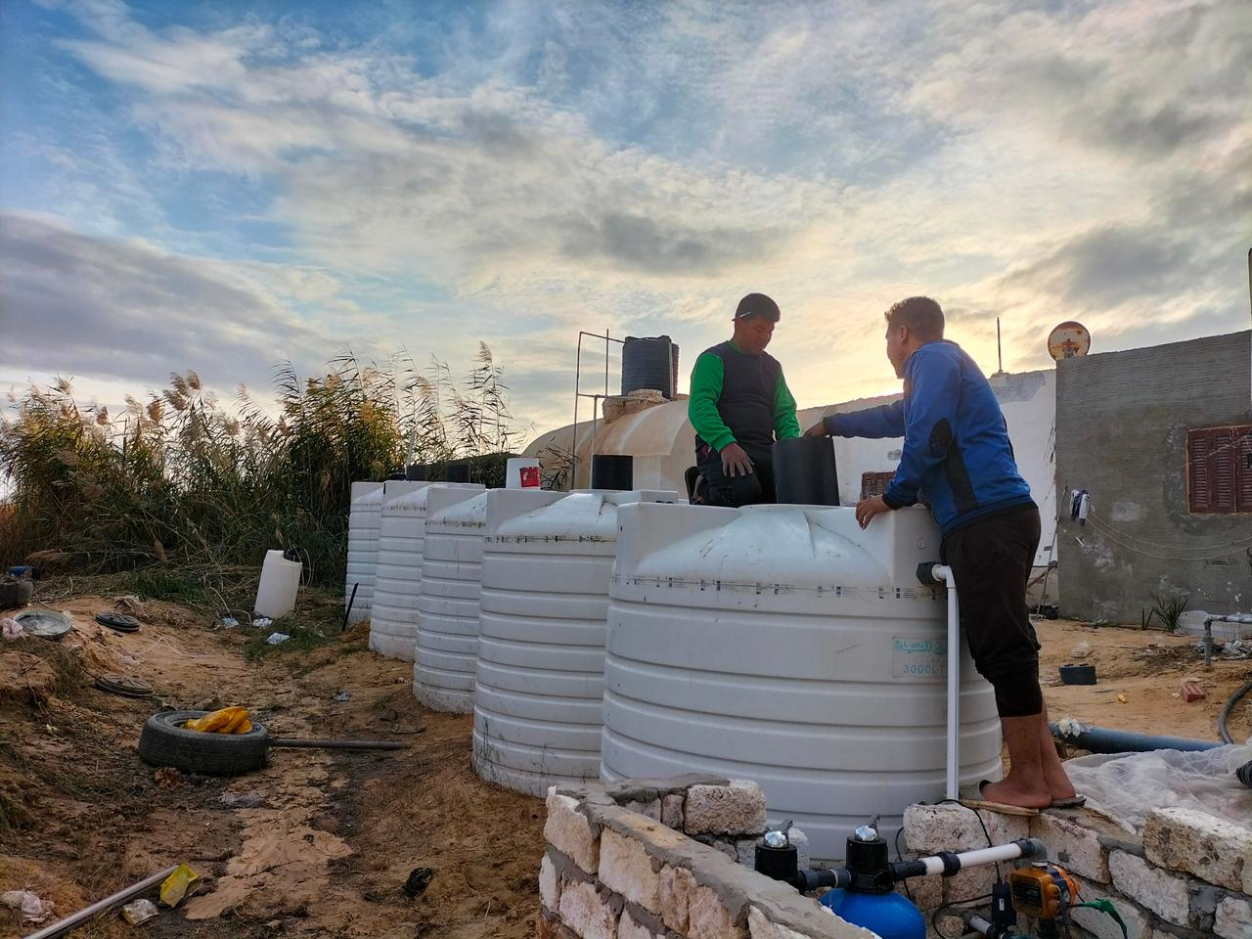
Our Products
3+ Domestic Wastewater
Treatment System
🗹 Lebanon
🗹 Egypt
Provides clean and safe water for irrigation
Safe for disposal
Saving water
Optimize your water resources
Compost production

Slide 34
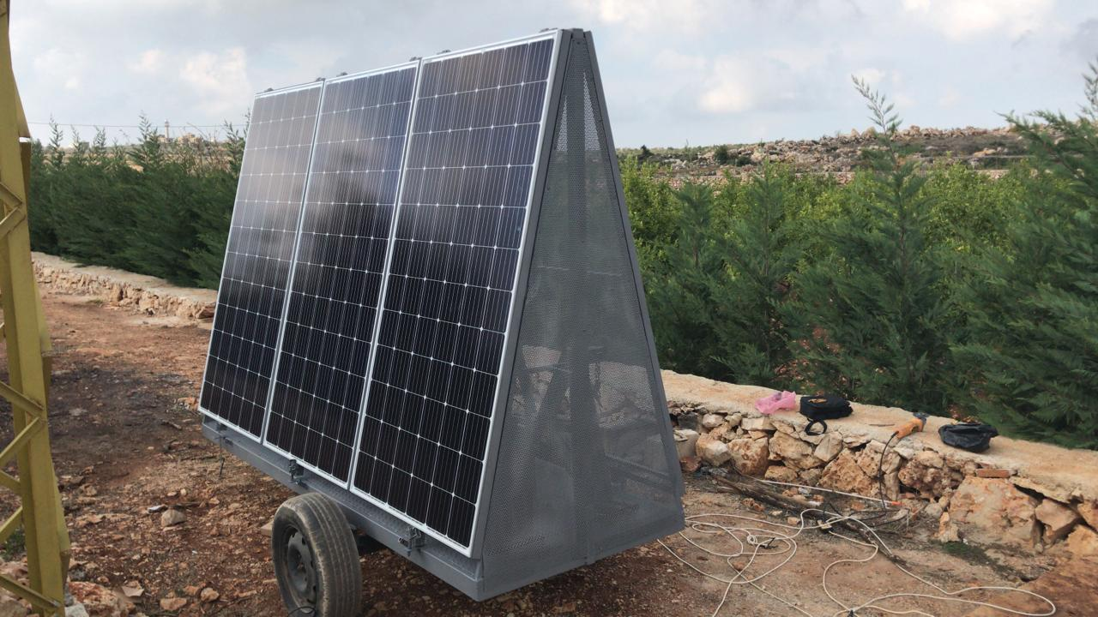
Our Products
2+ MSWP System
🗹 Lebanon
Solar-Powered Water Pump
Modular & Mobile
Integrate Water Treatment

Slide 35
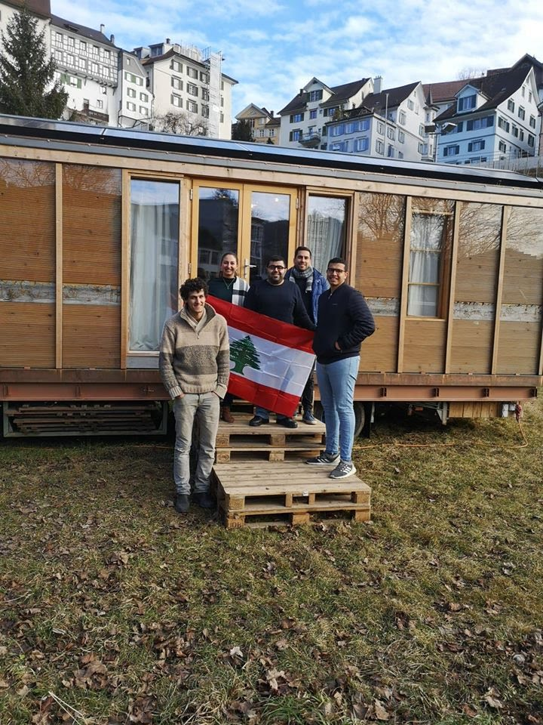
Our Products
1+ Rainwater Harvesting
and Treatment
🗹Switzerland
Modular, Mobile, and solar powered
Rainwater harvesting system and drinking reuse

Slide 36
IGT Roadmap to Success
Fish Breeding
Aquaponics
Hydroponics
Domestic Wastewater
Rainwater Harvesting
& Treatment System
Biogas
Biodiesel
Dutch Bucket
Expanding to Paphos, Cyprus!
2017
2019
2021
2023
2018
2020
2022
2024
PRO-Shield
& Solar
Trainings
Mobile Solar Water Pumping
Optima
Algae Cultivation
SWF

Slide 37
